Slide 1

Commander A Discord bot to make server management pain-free
Christian Sauls Software Engineering: COSC 412-101

Slide 2

What Is Discord? (A Quick Introduction)
A popular free proprietary messaging and VoIP application and digital distribution platform, launched May 2015
Over 250 million registered users
56 million active users per month
850 million messages sent every day
Popular with online personalities
YouTube, Twitch, etc.
Easy for content creators to interact with their audiences
Easiest way to create a community

Slide 3

Purpose of Discord Bots
Simplify administrative duties
Text commands instead of manually navigating and clicking buttons
Dynamically interact with your users
Automated welcome text
Stylized messages
Message thumbnails, hyperlinks, and more; known as “embeds”
Endless automation possibilities
High-quality user experience

Slide 4
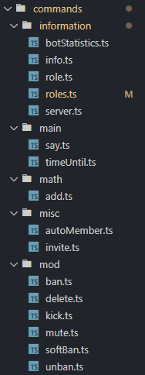
Commander’s abilities
Auto-greet
Moderation
!ban, !unban, !softban, !kick, !mute, !delete
Information
!stats, !user-info, !role-info, !server-roles, !server-info
Tools
!time-until
Math
!add
…and more

Slide 5
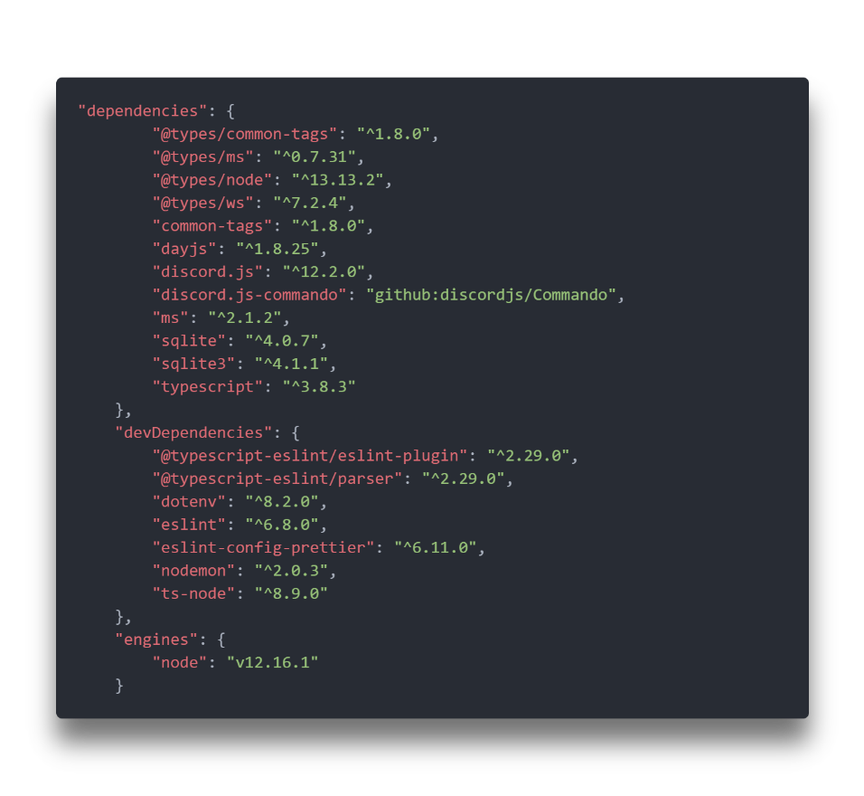





Technologies Used
Node application
JavaScript
Discord.js API wrapper library
TypeScript
Deployed on Heroku
Made with all the tools that developers already know and love

Slide 6

Live Demo

Slide 7


Future Plans
Functionality added incrementally
Database for per-guild configuration
Commander currently has assumptions about channels, roles, and permissions
Allow guild owners to set these variables per guild
Guild auto-configure
Take a freshly-created guild and automatically configure it
Prompted with choices during configuration: Restrict access until given member role? Greet new members? Set guild variables.
Music
Queue music to play in a voice channel
YouTube, Soundcloud, etc.
Endless possibilities with easy extensibility

Slide 8
Thank You
Questions?

